Slide 1
IUIE Advanced Reporting Workshop
University Graduate School
INDIANA UNIVERSITY BLOOMINGTON

Slide 2
Today’s Agenda
Use “valid values” and wild cards
Save and schedule reports
Use the “Advanced” option to refine report results
Upload a table via “Utilities”
Use a pivot table in Excel to analyze data

Slide 3
Valid Values and Wild Cards
SECTION 1

Slide 4
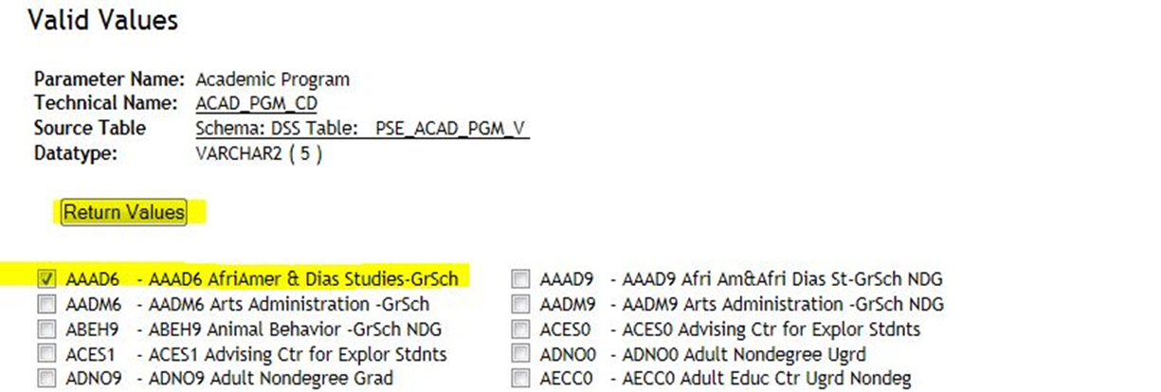
“Valid Values” – for when you don’t know the codes for a parameter value you need to use
The “Valid Values” button will give you a list of the valid codes for that particular parameter. Check the option(s) you need and press “Return Values”. You will be returned to the report request page with the value(s) you selected filled in.
Notes:
Sometimes you will see a radio button beside each option instead of a check box. This indicates you may only make one selection. With check boxes, you may make multiple selections. There may be a limit to the number of selections; however, IUIE will not inform you of the limit until you run the report.

Slide 5
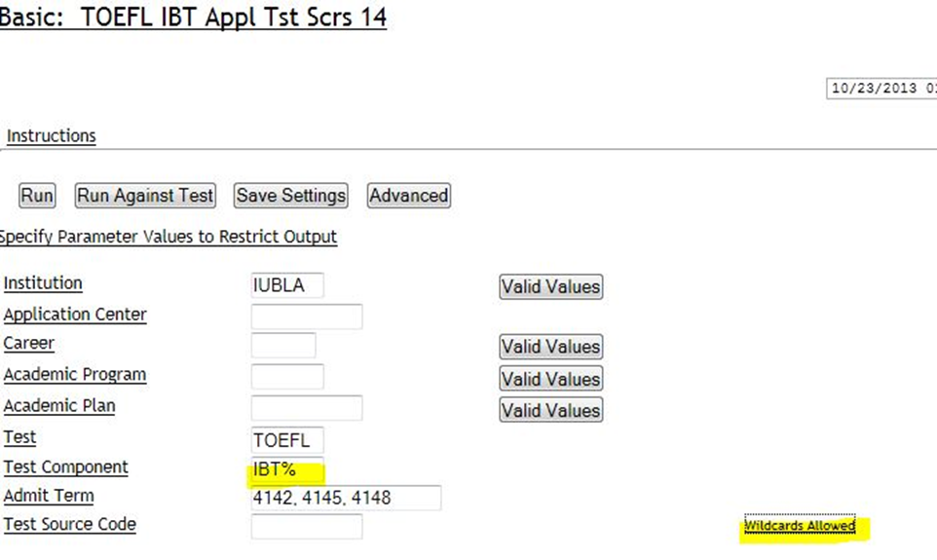
“Wild Cards” – for when one value for the parameter just isn’t enough.
When there are multiple values you wish to enter for a parameter there are two ways to do it. One is to list each one with a comma between, as the “Admit Term” above. The other is to use a “Wildcard”. In this case we wish to see all the components of the IBT TOEFL scores. Adding the % sign after IBT will give us any value that begins with IBT. You can also use the % in front of a value to return anything that ends with that. There are other options, like using ? To represent just one character. If you will click on “Wildcards Allowed” you will be directed to the Knowledge Base article that explains each option.
Notes:
I use GR% in Academic Group Code to limit it to Graduate School programs.

Slide 6
Using SQL to Refine Results
SECTION 2

Slide 7
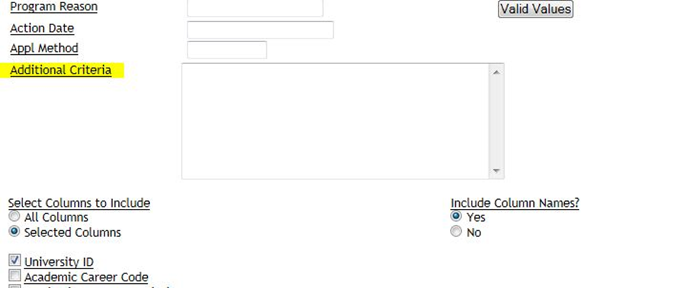
“Advanced” mode – when a parameter just isn’t enough
You can limit a report by fields that aren’t included in the parameter by using just a bit of SQL. Click on the “Advanced” button.
An “Additional Criteria” box will show up beneath the other parameters.
Notes:
Not all reports in IUIE offer the “Advanced” option.

Slide 8
Advanced Setting
You can limit a report by fields that aren’t included in the parameter by using just a bit of SQL. Click on the “Advanced” button.
An “Additional Criteria” box will show up beneath the other parameters.

Slide 9
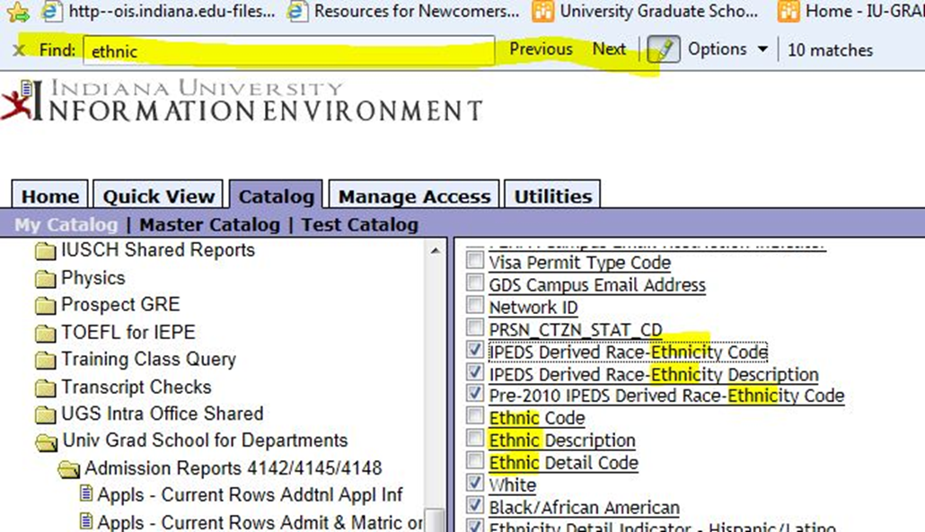
Advanced Setting
For example, if we want to only include Underrepresented Minority students in our output we can limit by ethnic code. You can use CTRL-F to bring up a search box, type in “ethnic” and then “Next” and it will highlight all the occurrences of “ethnic” within the parameters. Always use a derived ethnic code if it is available, as those are modified to exclude international students that may have chosen a domestic ethnic code. In this instance we want to use “IPEDS Derived Race-Ethnicity Code”.

Slide 10
Advanced Setting
Click on the field name you want to use. You will get a page that gives the technical name. You will want to copy it so you can paste it into the SQL statement.
You can construct the SQL statement two different ways:
(PRSN_DRVD_IPEDS_ETHNIC_CD = ‘2’ or PRSN_DRVD_IPEDS_ETHNIC_CD = ‘3’ or PRSN_DRVD_IPEDS_ETHNIC_CD = ‘5’ or PRSN_DRVD_IPEDS_ETHNIC_CD = ‘7’ or PRSN_DRVD_IPEDS_ETHNIC_CD = ‘8’).
-OR-
PRSN_DRVD_IPEDS_ETHNIC_CD in (‘2’, ‘3’, ‘5’, ‘7’, ‘8’)
Notes:
The codes that are considered URM are 2=Black/African American, 3=Hispanic/Latino, 5=Native American, 7=Pacific Islander and 8=Two or more Races.
Make sure to enclose any series of IF statement with parentheses to prevent the last IF statement from being executed on its own. If in doubt, enclose your entire SQL statement with parenthesis.

Slide 11
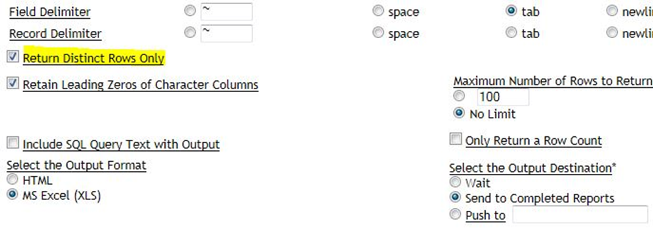
Advanced Setting
Enter this statement into the “Additional Criteria” box.
You should check the “Return Distinct Rows Only” box (if you aren’t using Advanced option this is automatic). Make sure to “Save Settings” so you don’t lose your hard work!
Notes:
Above SQL statement will pull students who meet those specific ethnic code criteria. Can only add additional criteria for fields that are available in the “Select Columns to Include” section OR the above Parameter section.

Slide 12
Utilities
SECTION 3

Slide 13
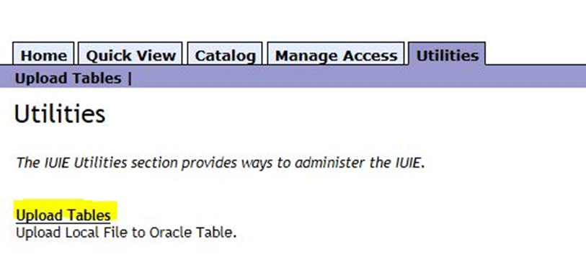
“Utilities” – uploading a table in order to run a report using limits that aren’t well represented by parameters.
You may not need this often, but there are certain situations where it is a huge timesaver. If you have a list of students, for instance that have attended a recruitment event, you can upload their name or email address. You should use student ID if you know they have at least submitted an application. Then you can use an SQL statement similar to the one we used for the ethnic codes to look for any value that is in the uploaded table.

Slide 14
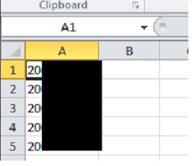
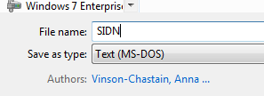
You can use an existing Excel workbook to start the process. Remove all the columns except the one you will be using, and remove any column header from that. Then save it as an MS-DOS Text file. You will be prompted at least once to confirm that yes, you really want to save it as a text file.
Utilities
Notes:
You can also use Notepad to create the list. Those automatically save as a text file.

Slide 15
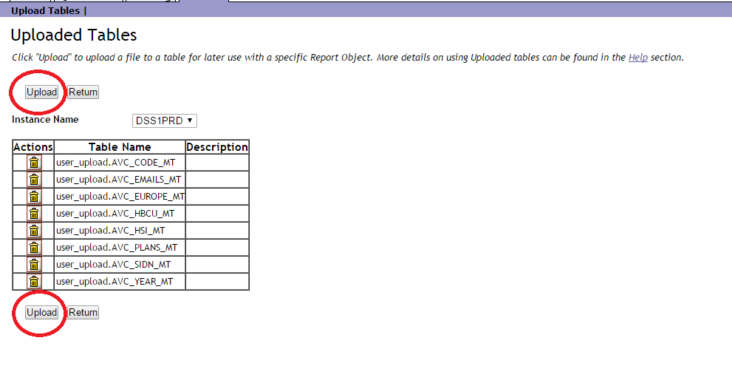
Utilities
When you press the “Upload” button from the Utilities tab you will see what tables you already have uploaded and have the option to upload another one. The “help” link takes you to a detailed Knowledge Base explanation of the process.
Notes:
You may use either Upload table. DSS1PRD is the production environment. This is the option you want to use for “Instance Name”.

Slide 16
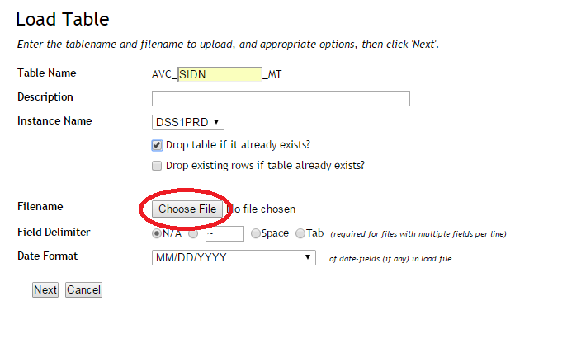
Utilities
You must enter a table name. When I upload a list of University IDs, I name the file “SIDN”, and since a table already exists with that name I choose “Drop table if it already exists, so all my data will be new. Then “Browse” for the text file you created in the previous step.
Notes:
Table Name will be the technical name of your table. The only part you name is the part in the box. The rest is populated by IUIE.

Slide 17
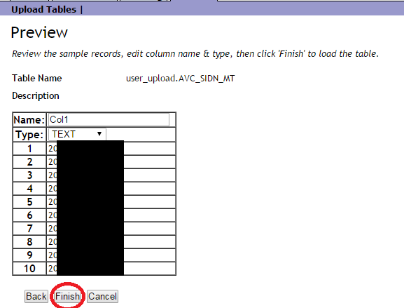
Utilities
When you have chosen your file you will see this preview screen. I usually just use the defaults on Name & Type (you can use numbers or dates instead of text, but I’ve not had an occasion to use them). If the data looks like what you expect, click “Finish”.
Notes:
I don’t change the “Name” because I find it easier to refer to “Col1” in the SQL than to remember what I named it.

Slide 18
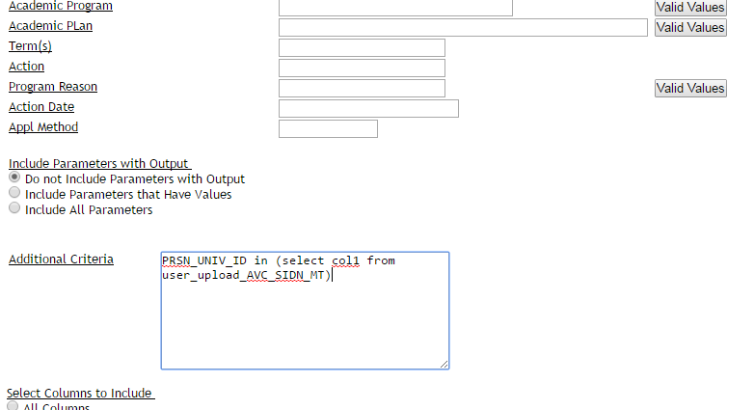
Utilities/SQL
You will need the technical name of the field, in this case University ID. The SQL is: PRSN_UNIV_ID in (select col1 from user_upload_AVC_SIDN_MT).
The SQL says: look for University IDs in the field called col1 in the table called user_upload_AVC_SIDN_MT and pull data for those University IDs.
Notes:
You may or may not need to add additional parameters. For this example, we did not as we looked up specific students. However, there may be situations where you upload a list to a table to use as criteria, and you have additional parameters.

Slide 19
Scheduling Reports
SECTION 4

Slide 20
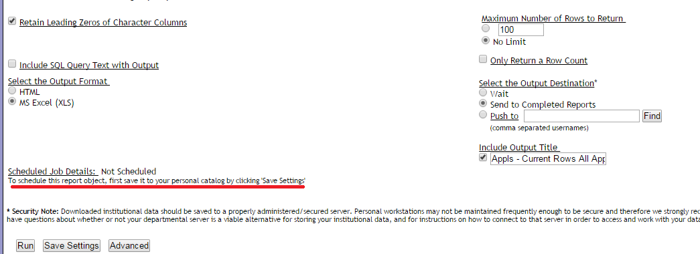
“Schedule” – when you want to run a report again, and again, and again . . .
Scheduling is useful for a report you run on a regular basis. It can also be used for a one time run, in a situation where you want the report run while you are not in the office. The report must be saved to “My Catalog” in order to schedule it. The “Schedule” button is near the bottom of the screen.
Notes:
This is the Appls – Current Rows All Applications report found in the ‘Univ Grad School for Departments’ >> ‘(SIS) Application/Admission Reports 4172/4175/4178’ Shared Folders. Once you save the report, the Output Title will change to the title you gave the report.

Slide 21
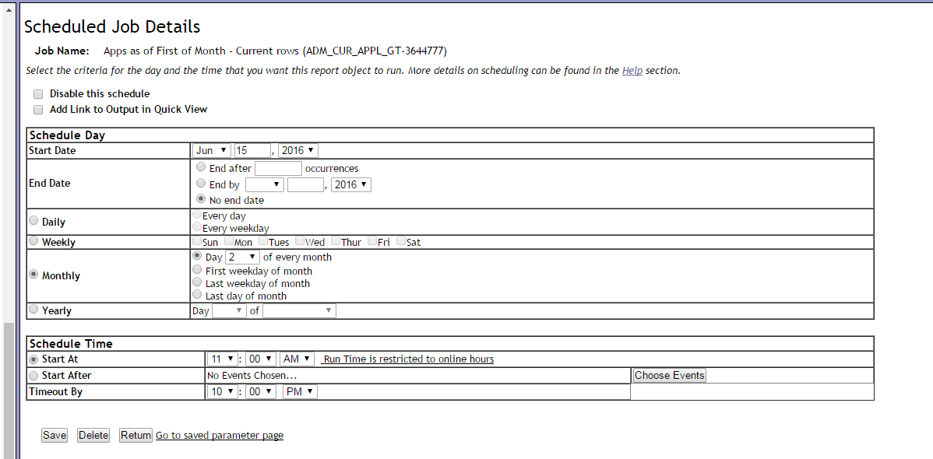
Scheduling Reports
Designate a Start Date. Choose from the daily, weekly, monthly or yearly options to determine the frequency of the report. Then schedule a start time, which must be within the IUIE online hours. Make sure to “Save” your choices. If you are scheduling a report that has a date range, you may want to change the saved parameters between runs. Either do that through “My Catalog” where the report is saved or use the “Go to saved parameter page” from here.
Notes:
Keep in mind that IUIE updates each day’s transaction every night. So, for example, if you want to include the applications that came in on the 1st of the month, you would want to wait to run the report on the 2nd.

Slide 22
Using Pivot Tables in Excel
SECTION 5

Slide 23
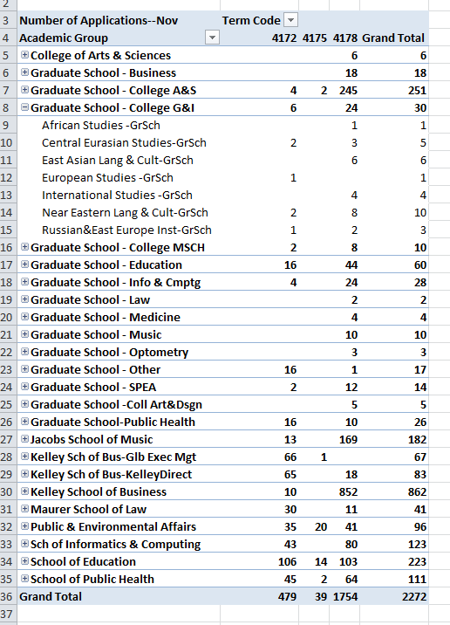
Pivot Table – an interactive table that links to raw data and allows quick analysis of data
Notes:
This is an image of a completed pivot table that shows the number of applications for each academic group by term for which they applied. The Academic Groups can be further broken down by Academic Program Description to show the number of applications to each program. The plus sign next to the name of each Academic Group indicates

Slide 24
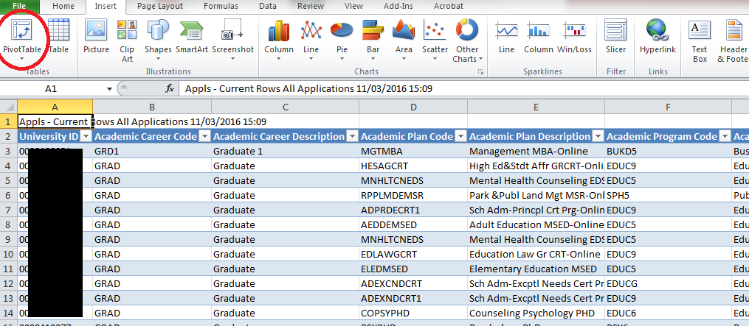
Pivot Tables
Start with the data pulled from your report. I put this into a table, but that is not a required step. On the ‘Insert’ tab of the ribbon, the first icon is ‘Pivot Table’. Select this.

Slide 25
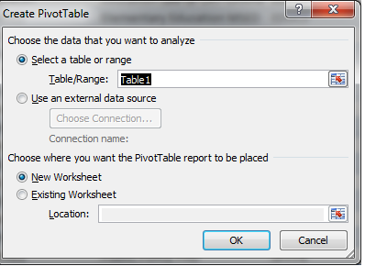
Pivot Tables
The table/range will auto select. Please double-check to ensure accuracy.
Choose New Worksheet for this example.
Click ‘Ok’
If you choose ‘Existing Worksheet’, you will be asked to select a cell as well as a worksheet. Make sure the cell is located in Row 3 or lower on the sheet. This will allow room for a report filter.
Notes:
You can place multiple pivot tables in one worksheet to create a dashboard of information. When placing multiple pivot tables on one sheet, you will need to allow room in between pivot tables for expanding options on each pivot table. Dashboard layout can take some playing around with to get an optimal result, but the end result is well worth it, as the data is more easily accessible for the users.

Slide 26
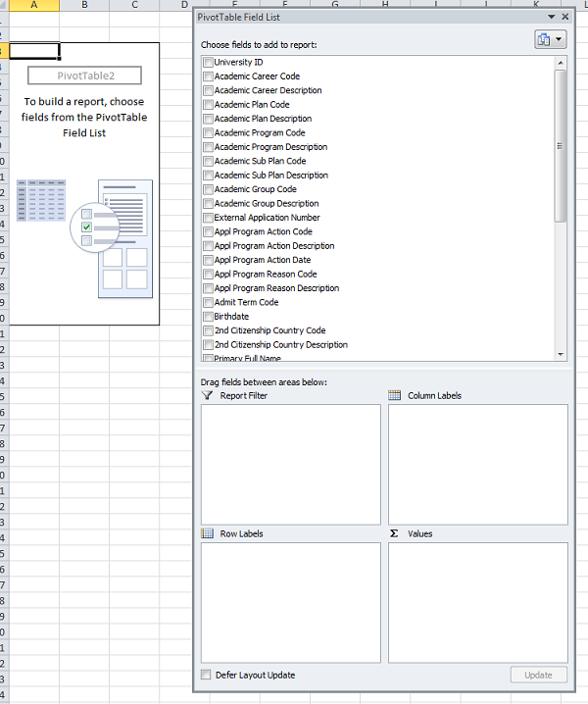
Pivot Tables
You will be taken to the worksheet and see a rectangle called ‘PivotTable#’ and the ‘PivotTable Field List’
Report Filter:
Filter pivot table by a set of chosen values (i.e. campus)
Row Labels:
Fields which allow you to break down data into categories
Column Labels:
Creates groups of data in columns. Allows for subdivision of row labels
Values:
The field(s) you want to subtotal and display in your table. The “meat” of your pivot table
Notes:
The PivotTable Field List will normally be located on the far right of the screen. The window can be moved as needed. If the Field List does not appear, there is a button to open the window under Pivot Table Tools>>Options>>Field List.

Slide 27
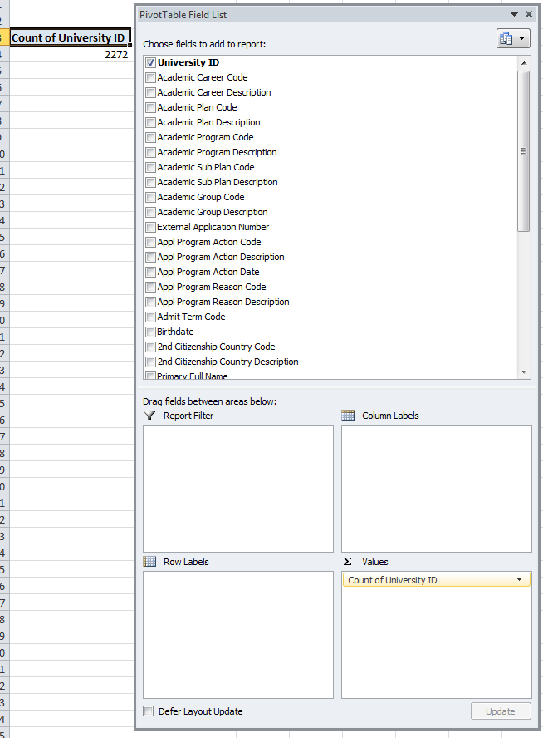
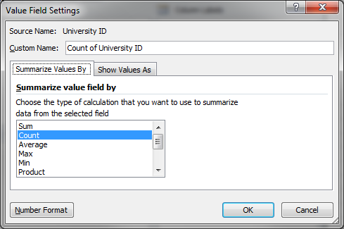
Pivot Tables
‘Values’ represent what you want to aggregate. In this case, we are counting the number of applications by school and program.
Select, drag, and drop the field to ‘Values’.
Excel will best guess how to aggregate the field, but can be changed by clicking on the down arrow to the right and selecting>>’Value Field Settings.
Notes:
Since the Values consist of the “meat’ of the pivot table, I prefer to start building the table there. You can list multiple fields in Values to aggregate multiple items.

Slide 28
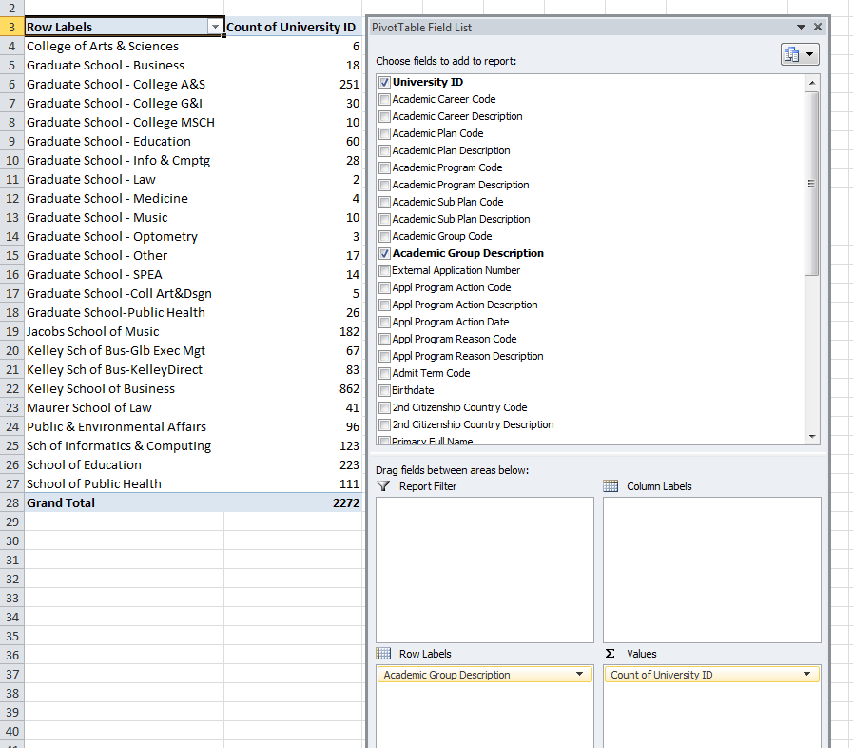
Pivot Tables
‘Row Labels’ allows you to break your aggregate value(s) down into categories.
In this case we added ‘Academic Group Description’, and now we see how many applications there are by school.

Slide 29
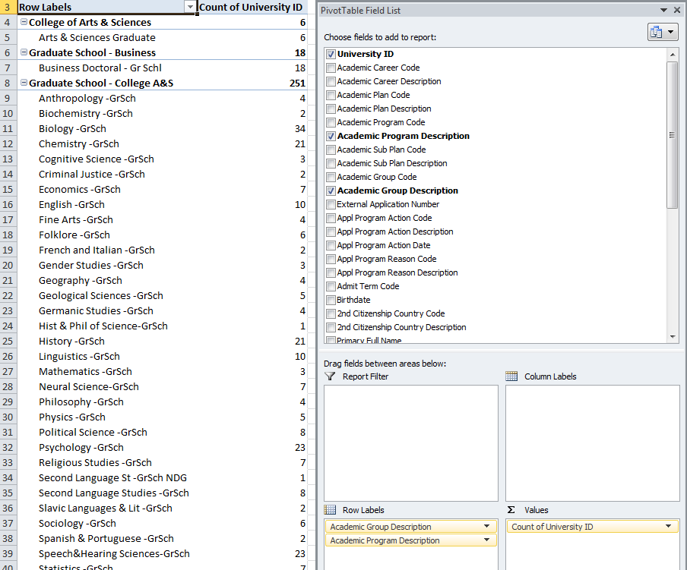
Pivot Tables
By adding a second field to ‘Row Labels’ (‘Academic Program Description’), now the count of each school is broken down by academic program.
The ‘minus’ sign next to each school name can be toggled to collapse or expand the pivot table to hide/show the programs.
Notes:
The order of fields in each section can be switched by dragging and dropping them within the box.

Slide 30
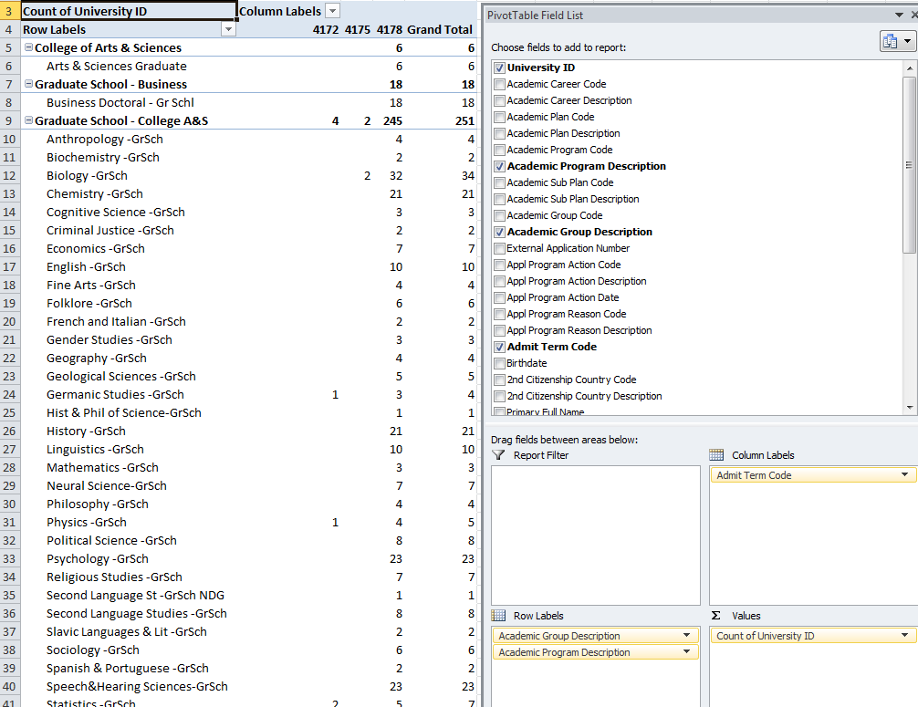
Pivot Tables
‘Columns’ allows you to separate each category into groups.
In this case, we added Admit Term Code, which allows us to see when students are applying to start in the programs.

Slide 31
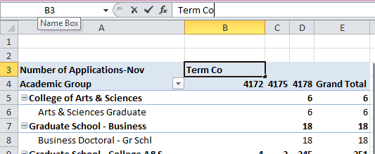
Pivot Tables
The headings of the pivot table can be changed by clicking within the cell you wish to change and typing the new name.

Slide 32
Tips and Tricks
SECTION 6

Slide 33
Tips and Tricks
Save your report prior to running!
Iterate upon your report aka “build your report in layers”
Isolate parameters that are not working
Always check the technical name of the field before writing SQL code. The technical name can vary for the same field depending on which table the report is pulling from.
When uploading a table to IUIE, it is easier to leave the ‘Name’ of the column as the default, ‘Col1’.
You will refer to the name of the column in your SQL statement in your report.

Slide 34
Tips and Tricks
The only part of the technical name of your uploaded tables that changes is the name you give each table. The rest of the technical name is auto generated by IUIE and is always the same.
You can copy the technical name from one report to past into another report, and only change the name portion if necessary.
Give the same name to both the upload file and the table you are uploading.
Copying and pasting SQL code from one report to another is a helpful and an efficient method of report building.
The colors Excel uses in the pivot table actually comes from your workbook theme. To change the set of accent colors, go to Page Layout >> Themes.
A field can be removed from a pivot table by unchecking the box in the field list.

