Slide 1
IUIE Reporting Basics Workshop
University Graduate School
INDIANA UNIVERSITY BLOOMINGTON

Slide 2
What is IUIE?
SECTION 1

Slide 3
Indiana University Information Environment
Report environment used for university business purposes.
User interface with the data warehouse.
Reports are created by UITS and other report creators on campus.
Updates each night.
Its purpose is for pulling data.
It’s beastly.

Slide 4
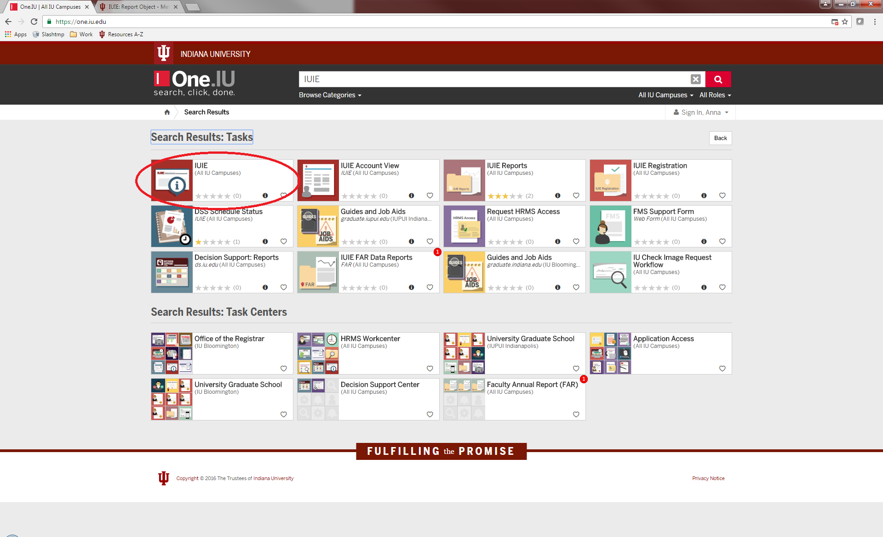
Accessing IUIE
You may want to access Outlook Web App for this workshop as well.
Notes:
Go to One.IU.edu and search for IUIE.

Slide 5
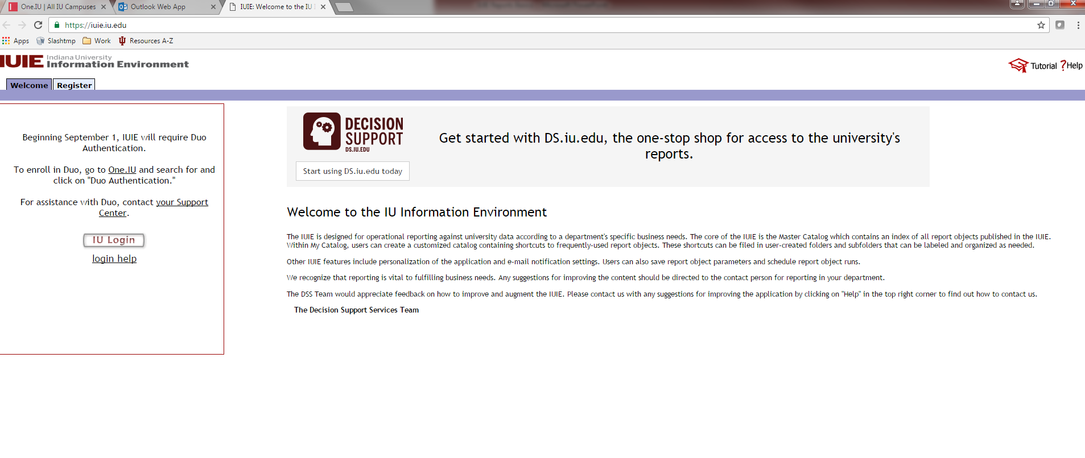
Accessing IUIE
IUIE requires both CAS and DUO logins.
Users must be approved by data managers to have access to system.
Row level access is set by data managers.
Notes:
Log in using CAS and DUO. Users will most likely be asked to complete FERPA and other data security tutorials.

Slide 6
Navigating IUIE
SECTION 2

Slide 7
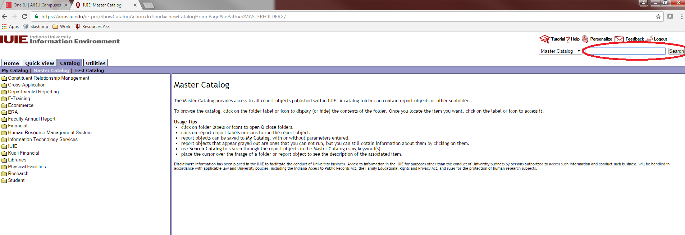
Navigating IUIE
Master Catalog:
Access every available report in IUIE
Search Bar:
Common (keyword) term
Technical name
  Ex: Table: ADM_CUR_APPL_GT

Slide 8
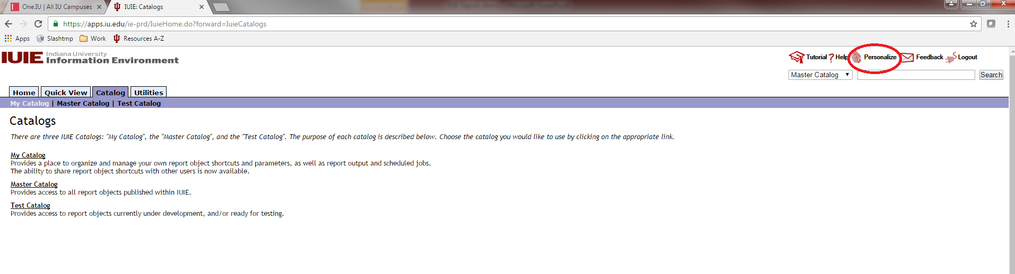
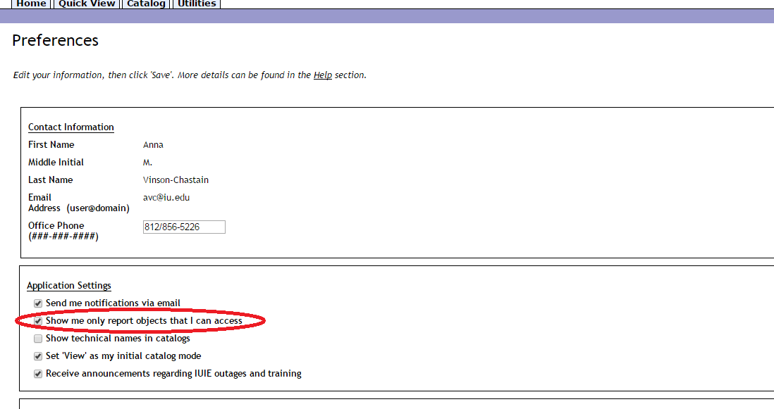
Navigating IUIE
Under Personalize>>Preferences:
Reduces the number of reports visible in the master catalog

Slide 9
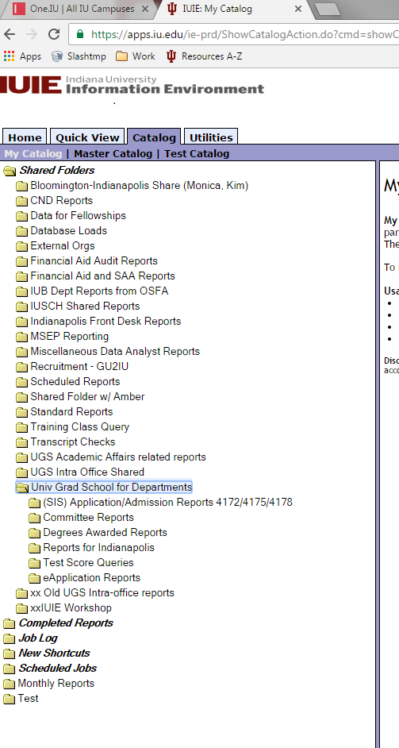
Navigating IUIE
My Catalog:
Shared Folders
  Group reports for your office
Completed Reports
  List of previously ran reports
Job Log
  Technical details of each report
New Shortcuts
  Saved reports (poorly named)
Scheduled Jobs
  Any reports you have scheduled to run
Any Additional Folders

Slide 10
Admission Reports

Slide 11
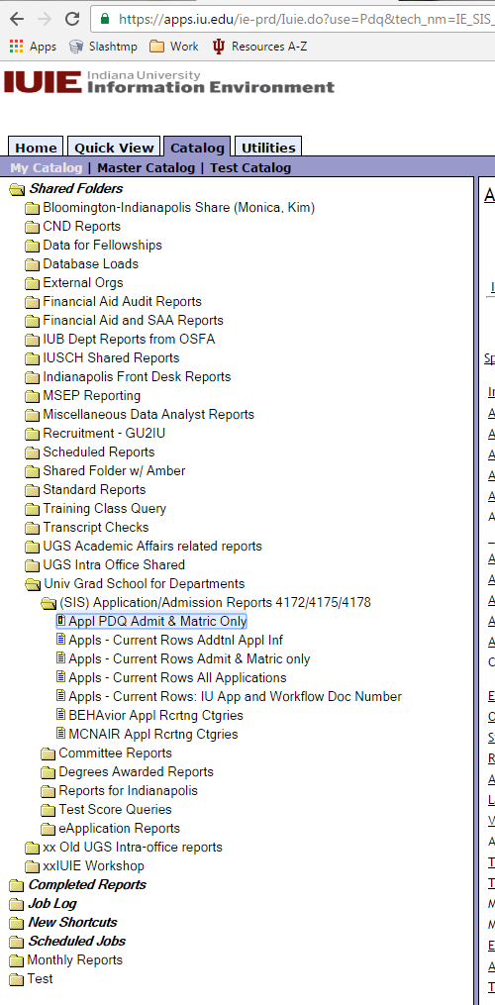
PDQ vs. Data Extract Reports
PDQ:
Pre-defined Query: contains raw data and the returned is determined by the parameters you input; data is already extracted
Data Extract:
Less limited than the PDQ---you have more control over which parameters to include; data is pulled after you hit run

Slide 12
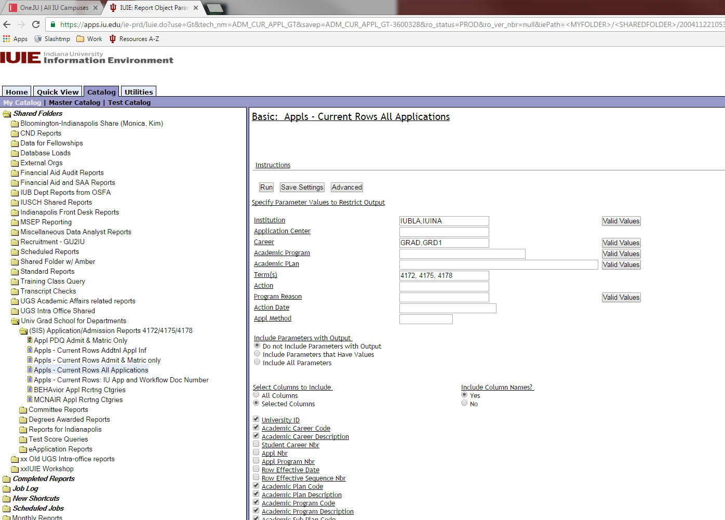
Current Rows All Applications
You do not need to select your particular program as your row level access to the data will take care of that.
If you prefer to only see one term you may remove the other terms from the parameter box.

Slide 13
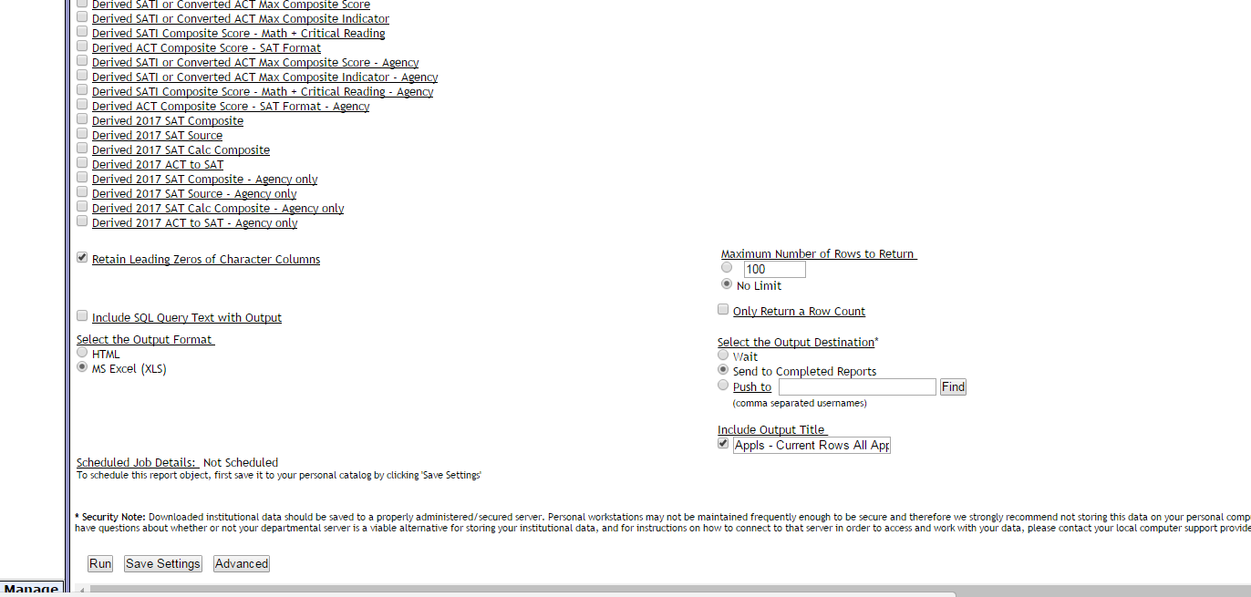
Current Rows All Applications
After making all of your selections, scroll to the bottom of the report.
Make the following selections:
Retain Leading Zeros
  This keeps student IDs from losing zeros
No Limit
Send to Completed Reports
  Sends email when report is finished generating
    You can keep working
MS Excel (output format)
Include Output Title (optional)
Click “Run”
Note: “Save Settings” is a good idea before running because the report settings do not save otherwise.

Slide 14
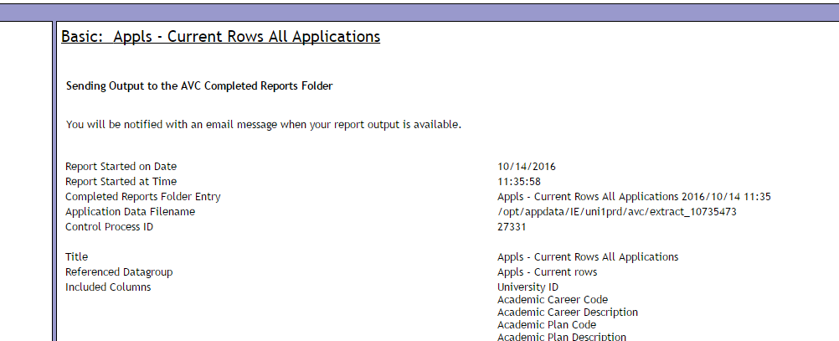
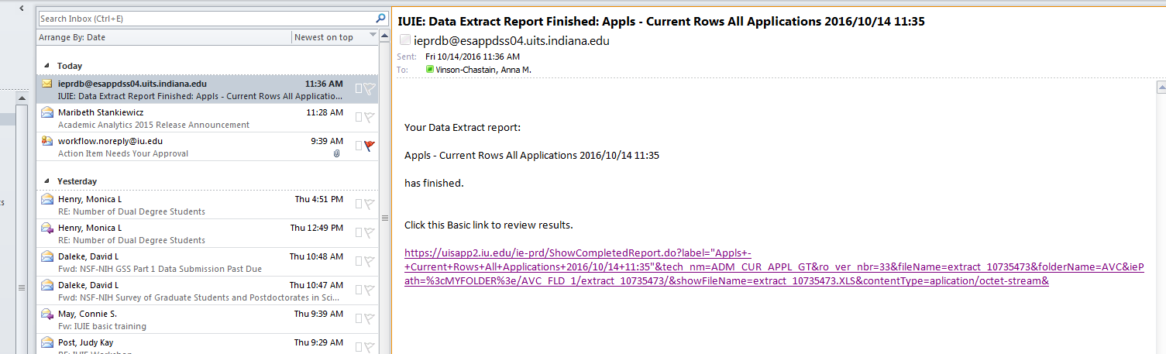
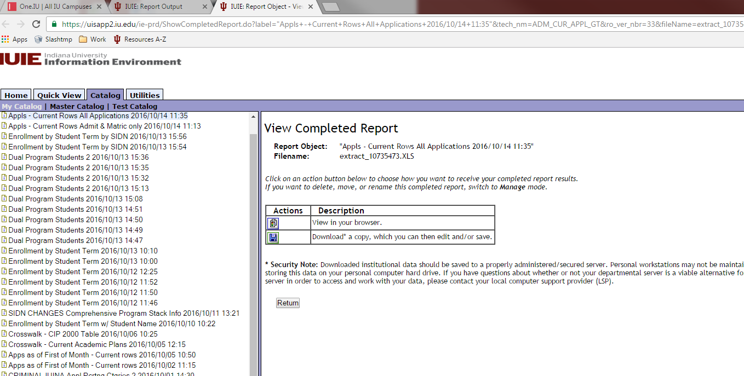
Report Output
You will receive a link in your email to download the results.

Slide 15
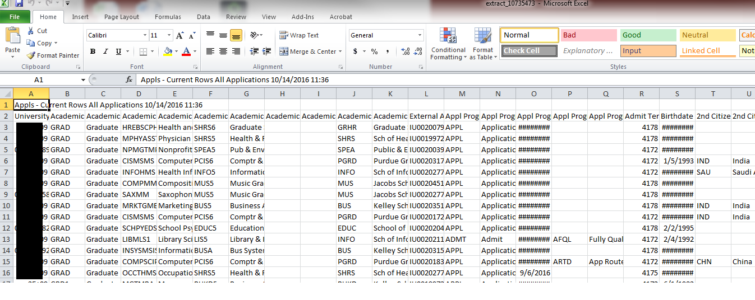
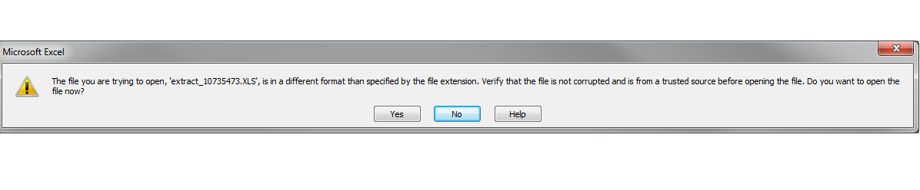
Report Output
The download file is actually a text file. Answer “Yes” to this question, which will open your output in Excel. Then, do File>>Save As>> to save this file as an Excel workbook or CSV.

Slide 16
Excel Tricks

Slide 17
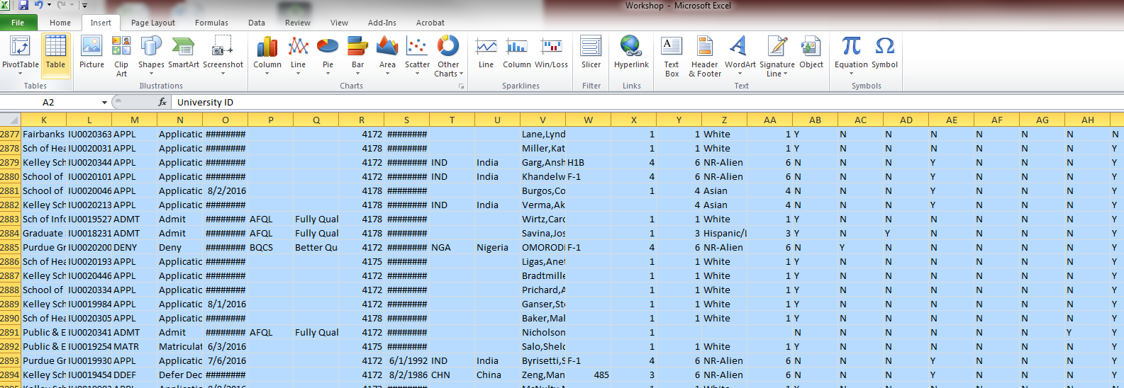
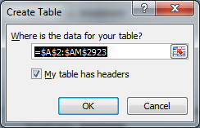
Creating a Table
Click in top left cell of data (A2 for this particular set). Simultaneously press Shift + Ctrl + right arrow to select the top row of the table. Press Shift + Ctrl + down arrow to select to the bottom row of the table. All of the data should be highlighted. Navigate to the Insert tab on ribbon. Click on “Table”. The “Create Table” window will open. Double-check to make sure the selection is correct and that the “My table has headers” is checked. Click “Ok”.

Slide 18
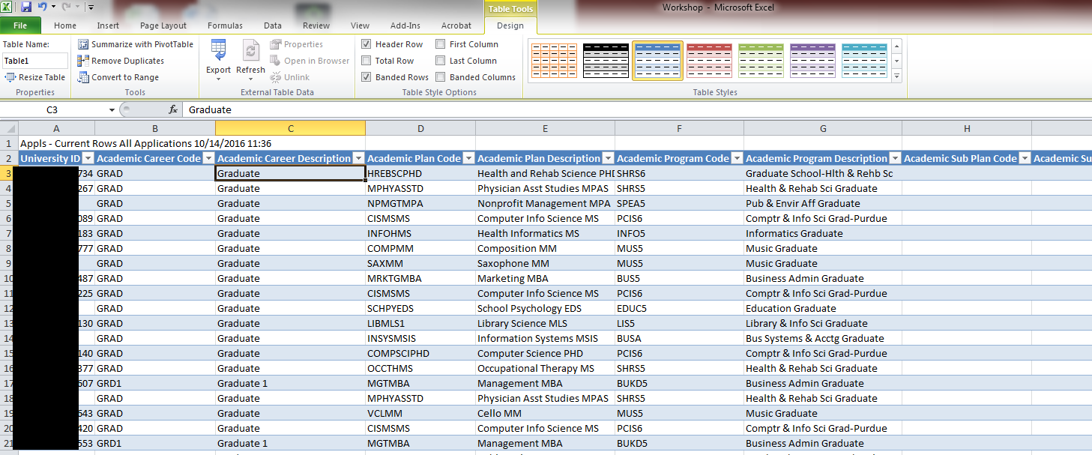
Creating a Table
Table facilitates filtering and sorting the data. Easily copy and paste subsets of data into other spreadsheets.

Slide 19
Finding the Correct Report

Slide 20
Useful Tables

Slide 21
Useful Tables
These tables represent a starting point for searching in IUIE.

Slide 22
Helpful Hints

Slide 23
Hints
The best way to learn more about the IUIE is by actually running queries yourself.
Don’t forget to use the “Search Catalog” option – it will save time.
Clicking on the name of the report will give you more information about the query or table.
Clicking on the names of the fields will link you to more information about the data in the fields, including the technical name of the field, possible metadata that explains more about the field, and what other tables contain this field.
Clicking on the “Valid Values” button will allow you to select only the values you want.

Slide 24
Hints
If you are not sure exactly what data is found in each field, print values for all fields using one of your own students (or yourself) as a “test” and then comparing the output with known values in SIS.
Use the “Advanced” button (when using data extracts) to add additional criteria. This will allow you to limit your population so you don’t have as much editing when you get output. But everything in the “Additional Criteria” box has to be written in SQL using the technical names of the fields.
The “no bio” data extracts run more quickly than the other data extracts.
Limiting the number of records will allow the queries to run faster so you can refine your query before running the entire report, but don’t forget to take the limit off before running your final query.
Send to completed reports whenever possible. This will allow you to continue working instead of waiting for your query to complete.
Always save your report objects in My Catalog so you can modify them later. You won’t be happy if you have written a complicated query and then forget to save it!

